Slide 1
Transcriptomes part 2
Characteristics & quality measures
of RNA-seq transcriptomes
impact of these characteristics on analysis methods
impact on biology conclusions
>these are very rich - yet imperfect - data
>know what biological questions you can address
>learn what is solid and when to worry
the relationship of “co-expression” with co-regulation
inferences

Slide 2
Basic RNA-seq experiment:
Goal is usually to learn about all mRNA by using polyA,
misses histones and other similar
includes lncRNAs; includes some partially processed RNAs
AAA
AAA
AAA
AAA
AAA
AAA
2X Poly(A)
selection or selective priming of RT reaction by oligo dT
AAA
AAA
AAA
AAA
AAA
AAA
Fragmentation and
Reverse transcription
Sequencing,
mapping
Relative Quantitation
3X
2X
1X

Slide 3

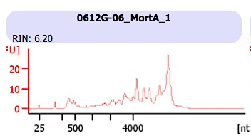
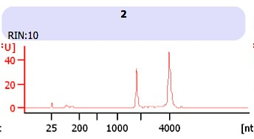

Quality of input RNA is critical for most current RNA-seq methods
RIN = standard RNA Integrity measure below based on rRNA profile
“Bioanalyzer”, a common microfluidics instrument, used for sizing, quantification and quality control of RNA, DNA.
RNA integrity number (RIN) is a quantitative measure of RNA integrity on a scale of 1-10 (most-least degraded).
Any sample with RNA integrity score of 8 or higher is suitable for the various common RNA-Seq variations.
a new short fragment input metric has been devised for RNA from FFPE (formadehyde fixed and parafin embedded source tissue) and will soon be published. We care about this because it helps to make possible routine RNA work on human tissue samples due to standard pathology practices

Slide 4
Quantifying transcripts
Absolute quantification is the goal – though not generally achieved (revisit later)
1) same RNA compared across samples
2) entirely different transcript (from different genes) compared within a sample and across samples
3) different isoform transcripts within a sample or across samples
Coverage
Given a set of
transcripts and
mapped reads,
determine transcript
Expression levels.
Isoform A
Isoform B
Genome

Slide 5
Computational challenges posed by RNA-seq
Reliable and efficient mapping of short reads to genome.
mapping reads across splice junctions.
Reliable transcript assembly (sophisticated, but unsolved)
More difficult in larger, complex genomes due especially to orthologs, pseudo-genes, splice isoform diversity (real
and computational artifacts)

Slide 6
Overview of RNA-seq data analysis
No genome
RNA-seq
reads
de novo assembly
Gene annotations
Reference genome
Mapping of reads
ab initio assembly
Transcriptome
With genome
Quantitation
Expression and significant Differential expression

Slide 7
Differential expression
Test for differential expression based on counts:
at gene and exon levels DEGSEQ, DEXSEQ.
harder to do at transcript level: Uneven coverage
confuses – lack of long distance contiguity/phasing
Some relatively current tools designed for transcript level quantitation:
Cuffdiff (Trapnell, 2010 updated 2014)
eXpress (Roberts, 2013)
FluxCapacitator (Montgomery, 2010 updated 2014)

Slide 9
single read mapping - consider effects of
mapping to whole genome, whole gene vs
processed transcriptome
Unspliced junction
or intron reads
map to whole gene models
or to genome; not to
the spliced transcriptome
By default, people generally mean
a “spliced transcriptome model” when they say
map to the“transcriptome”
pre-mRNA
Exon
Intron
Exon
Intron
Exon
RNA processing
mRNA
Exon
Exon
Exon
Sequencing,
read mapping
Spliced read
Unspliced exon
read
Unspliced junction
or intron read
mRNA
Exon
Exon
Exon

Slide 10

RPKM Reads Per Kilobase of exon per Million reads
FPKM
TPM
TPC or CPC (single cell mainly — though this is really most desirable for biology)
Where N = Total reads mapped
L = Length of region
Genome
Gene A
Length = 1000 bp
Gene B
Length = 1500 bp
Assuming 1
million reads mapped
RPKM = 10/1kb = 10
RPKM = 15/1.5kb = 10
If paired-end reads, then Fragments Per Kilobase per Million of mapped reads (FPKM)

Slide 11
Data characteristics affect the analysis and
conclusions you can draw:
Example = uneven read coverage levels due to biochemistry
of RNA/cDNA
Transcript coverage levels differ along their lengths depending on specifics of library construction procedure.
Fragmentation before or after reverse transcription.
mRNA
Exon
Exon
Exon
Sequencing
mRNA
Exon
Exon
Exon

Slide 12
Sequencing biases
GC-rich and GC-poor regions are under-sampled during sequencing by some chemistries (e.g. Illumina).
specific enzymatic biases
The not-so-random nature of random priming
mRNA
ATCTTAAATATCGTCTGACTGACTGTCGTACGCGGCCCTATCGTACGTCGT
GC-poor
GC-rich

Slide 13
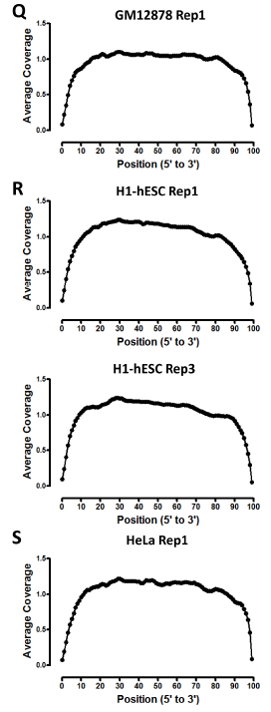
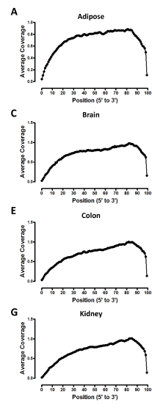
RNA integrity affects typical RNA-seq
ENCODE Cell Lines ENCODE2
Human Tissues (HBM and ENCODE 3)
shown: mRNAs>1000
normalized
Post mortem tissues
pose special challenges
Longest RNAs are
more affected
5’ exons
under-represented more
in some samples
than others

Slide 14
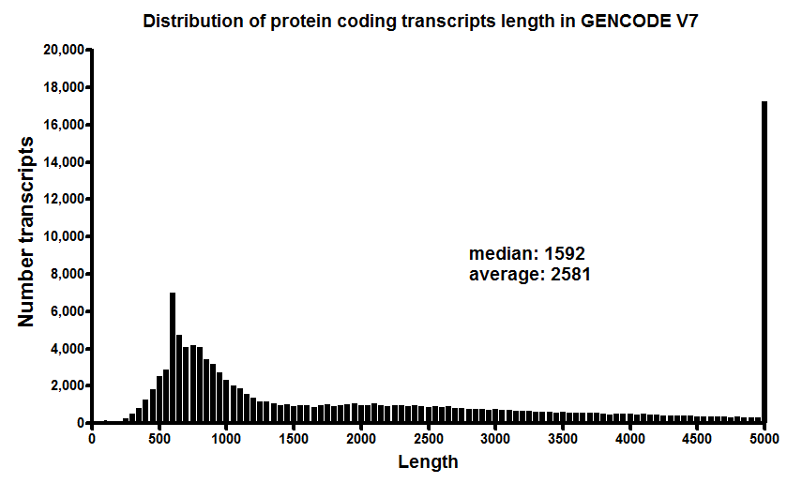
Global mRNA landscape Implications for ENCODE RNA-Seq data
read length – major platforms

Slide 15
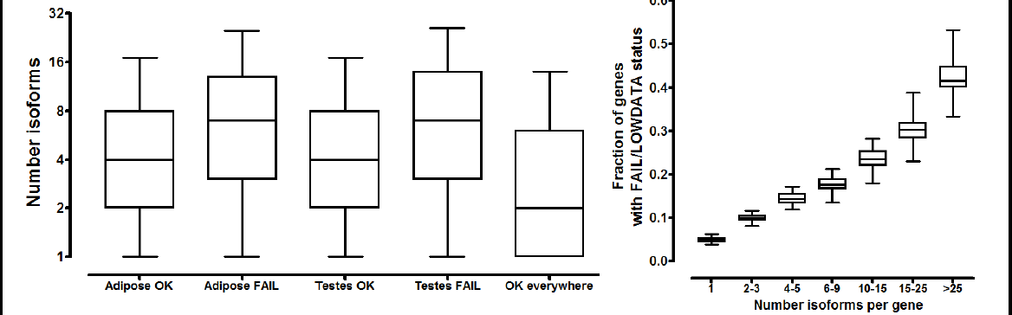
Too many isoform choices in transcript models reduces confidence in quantification
The Y axis is a measure of low confidence
extracted from Cufflinks quantification stats.
The point you need to learn is that isoform complexity
combined with relatively short read data gives the
effect below.
This is why compromises
with locus level
quantification or
exon-level quantification
are used- Next slide
YYY
Frxn genes w low conf. quant.
OK Poor OK Poor OK
Isoform number per gene

Slide 16
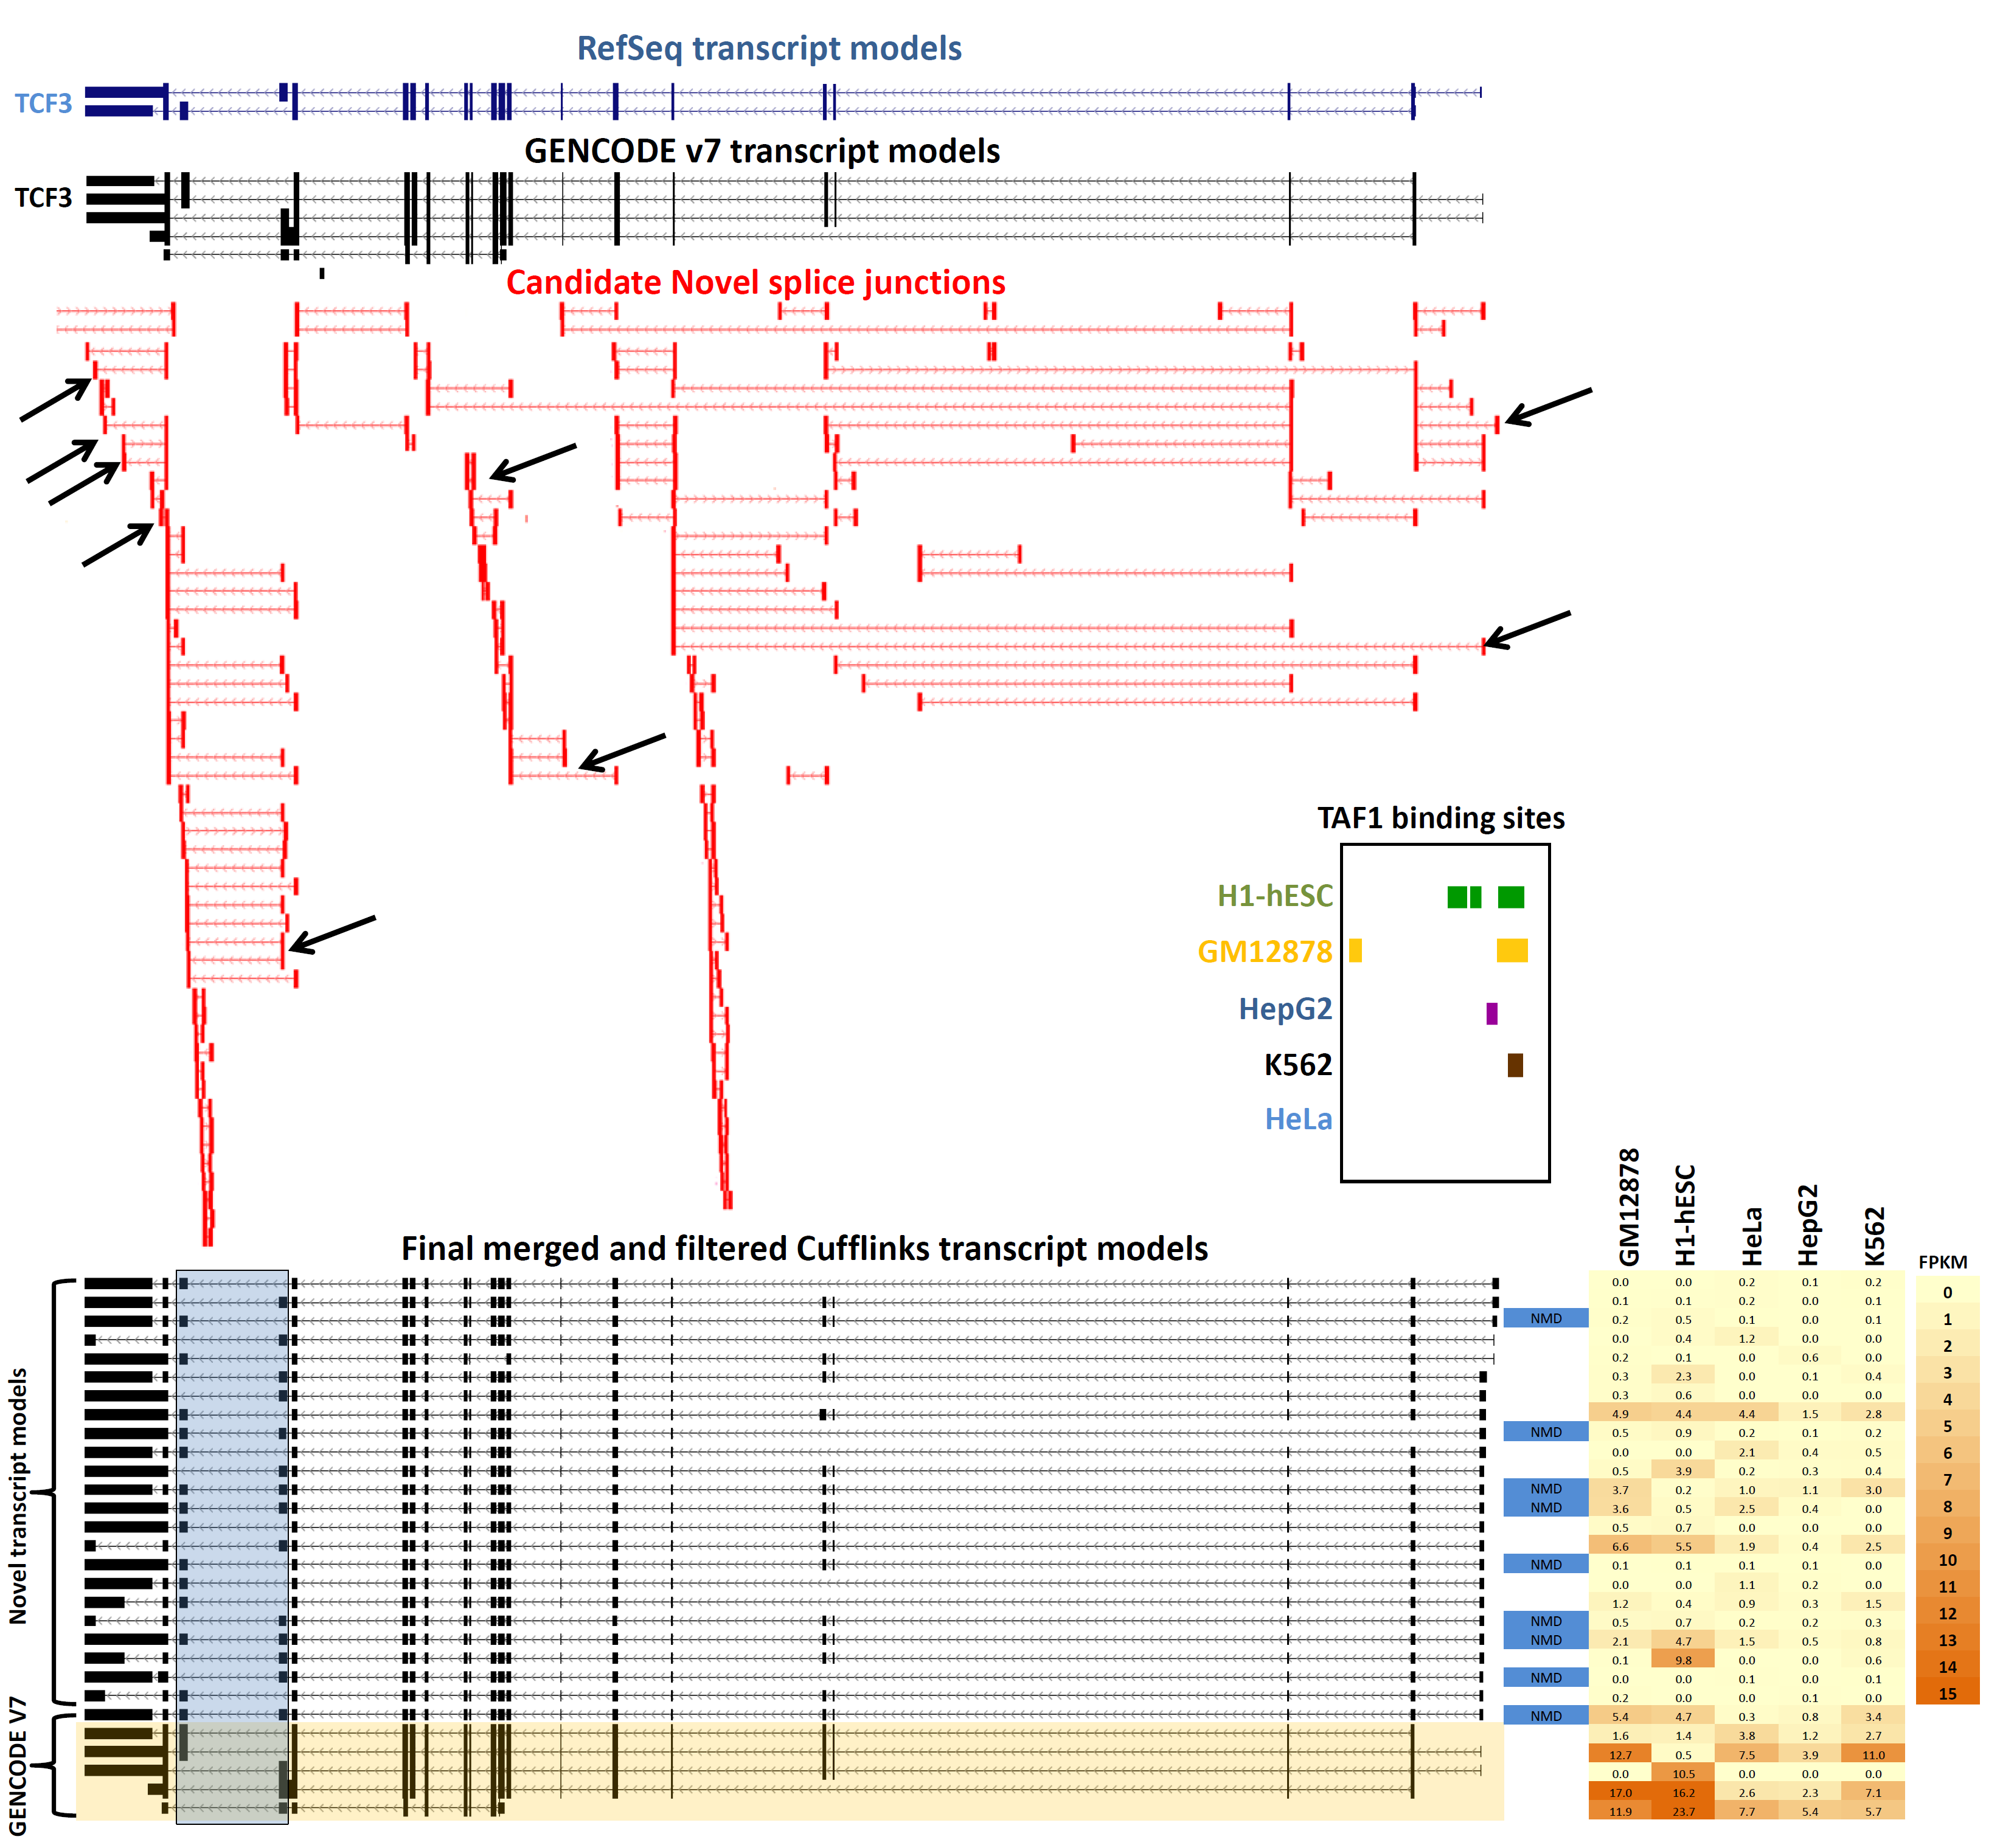
TCF3: Well known case of meaningful alternative splicing in “average” 20-Exon gene
This gene illustrates
a known important
alternate splice
choice (red arrows)
plus many
other choices
(most are new from RNA-seq data). Then filter transcript models as shown below; allocate FPKM to get results on right
Analysis by G. Marinov

Slide 17
Seek explicit splice-crossing
sequence reads to “support”
assignment of FPKM to an isoform
model.
DEX-seq output per next slide
nonsense
mediated
decay
predicted
Note large fraction of length of mRNA in 3’ UTR
Note diversity of PA-stops and 3’ internal splices--- this has large influence on transcript level quantifications
what if some samples are more 3’ biased than others?
Analysis by G. Marinov

Slide 18
Differential transcript expression
Locus level mRNA – looses biology but is realtively robust
exon level & splice level – regains some biology, becomes more complex
transcript isoform level – conceptually most desirable
but also very complex and most difficult to do with confidence
Aim high: determine differential expression at the transcript level
Test for
differential
expression
Condition 1
coverage
Condition 2
coverage
Isoform A
Isoform B
Genome

Slide 19
Differential expression
Goal: To determine the set of differentially expressed genes, transcripts between two conditions or time points in a time-course experiment.
Approach:
Determine gene-level, transcript-level, and/or exon abundances
Test for differentially expressed genes and transcripts e.g. test for statistical significance of differences between the expressions of genes from different conditions, time points.

Slide 20
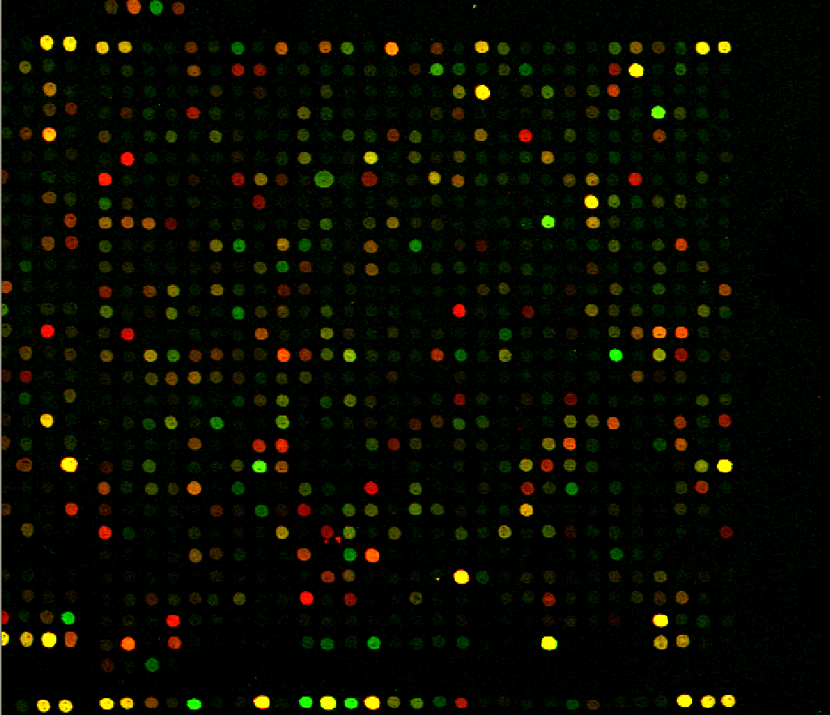
Additional mRNA (cDNA) data-types and
findings remain important, usable, useful
Microarrays:
Based on hybridization to pre-selected gene probes.
Inherent background from hybridization chemistry makes measurement of the lower abundance RNAs quite noisy.
Dynamic range issues
Much important biology
discovered using them
informatics tools devised, some (NOT ALL)
carry through to RNA-Seq etc.
> clustering algorithms
> multiple hypothesis testing issues
confronted. Bonferonni
http://www.microarray.org/sfgf/

Slide 21
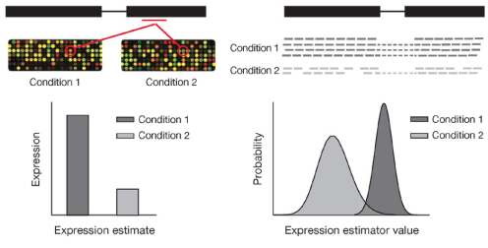
Basic analysis similarities and differences
RNA-seq measurement of gene expression differs because it is discrete counts in contrast to continuous intensity distribution of flourescent signal (microarray).
Microarray
RNA-seq
(Garber, 2011)
Therefore, statistical methods developed for microarrays are not directly applicable to RNA-seq analysis without modifications.

Slide 22
Parametric statistical approaches for RNA-Seq
A parametric approach will:
model the distribution of the read counts by using a known probability distribution e.g. Poisson, negative binomial etc.
estimate the variance from the local and common dispersions of the genes in the samples.
determine differentially expressed genes by calculating p-values and false discovery rates (fdr).

Slide 23
Replication “technical replicates” versus “biological replicate”. ideally want both. typically the former
replicates are needed to estimate the common and gene-wise dispersions
replication controls the false discovery rate
always safer to draw conclusions from data in the presence of replicates.
technical replicates become critical if samples are sequenced on different platforms – Discuss with experimental protocol tree what “technical replicate” means. Return to this issue for single cell transcriptomes
“biological replicates” contain the sum of technical variation and biological variation. The nature of “biological replication” for RNA experiments differs with experimental designs.
>>Consider expected differences between inbred mice of one gender, age, controlled environment versus typical human samples.

Slide 24
Standard statistical framework for RNA-seq
Simplest approach: many reads (most often >20 million) and low probability of mapping to a gene suggests a Poisson model.
Poisson model:
variance equal to the mean
Negative binomial (NB) model: number of successes x, until a specified number of failures (r) is reached
variance need not equal mean
tolerates positive correlation among events (unlike Poisson)
Negative binomial used as better model for differential expression (requires replicates):
Differentially expressed genes cause increased dispersion

